Slide 1

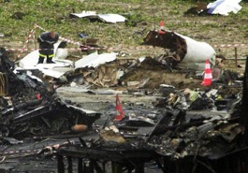

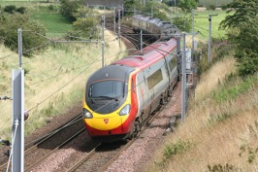
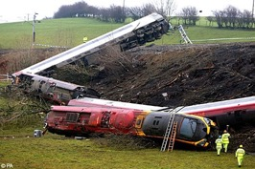
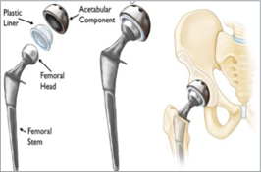
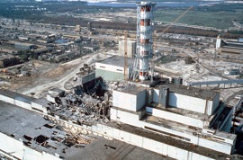

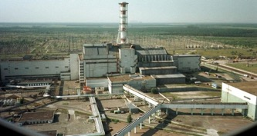
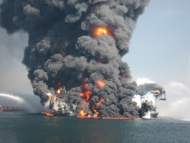
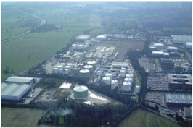
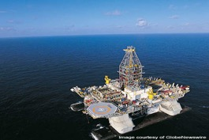
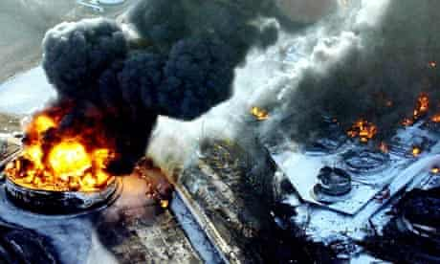
A Service Perspective on Accidents
Kevin King
Product Safety Manager, BAE Systems Maritime
Mike Parsons
SCSC Director and Safety Consultant, CGI UK
Mark Sujan
Senior Human Factors Consultant, Human Reliability Associates
SSS ’20, York, 11 February 2020
Notes:
Concorde - The strip of metal on the runway was found to be a jet engine part that had fallen from a Continental Airlines DC-10 in the course of its own takeoff, a few minutes ahead of the Concorde. The engine part (a thrust reverser wear strip) had recently been replaced in routine maintenance. The mechanic who did the work used a strip made of an alloy with 90 percent titanium content, not stainless steel as specified by the manufacturer of the engine.109 passengers and crew + at least 4 on the ground
Greyrigg – Although not the only factor in the incident a missed track inspection 5 days earlier was seen by the RAIB as one of the three main contributory factors. – 1 passenger died
Hip Replacement on NHS – Incompatible prostheses from different manufacturers used in same operation.
Chernobyl – 1986 was the result of a flawed reactor design that was operated with inadequately trained personnel – a failure of the ‘staff-training’ service
Buncefield – level gauge stuck at random times after a tank service 4 months earlier. Independent shut-off switch no padlock to allow its check lever to work. secondary and tertiary containment inadequately maintained
Deepwater Horizon – Failure of the service to pour cement into the well. weaknesses in the cement slurry design and service governance concerning testing, quality assurance and risk assessment.

Slide 2

Contents
Introduction
Principles
Analysis
Reproduced from americaspace.com © NASA, 1986
Introduces the concept and benefits of Service Assurance
Summarises the 6 principles of Service Assurance
Analyses Accidents in the Marine, Aviation, Health and Rail sectors through the lens of Service Assurance
The analysis presented herein has no legal standing whatsoever.
It is the authors’ interpretation; they are not speaking on behalf of their employers.
2

Slide 3
Introduction
SAWG needed worked examples to tie to our guidance
True value from evidence in public domain – www.gov.uk
Accident Investigation Branches – Marine (MAIB), Aviation (AAIB), Healthcare (HSIB) and Rail (RAIB)
Undertook analysis – Sectors – formal reports not considered service perspective
Our paper draws on work of the SCSC SAWG
The purpose of this presentation is not to discredit, contradict or challenge the existing accident analysis but simply to view these incidents through the lens of service assurance.
Notes:
Following on from Alan’s update on the SAWG, over the next 30 minutes I will be detailing some real world examples of service failures and why the SAWG believe there is a need for pan-industry guidance in this area.
High level narrative against techniques – how these have supported our analysis, using guidewords to determine service malfunctions
Ties service elements of accidents to guidance being developed by the Service Assurance Working Group (SAWG); More later
The term “Service” is much overloaded; We do not provide a precise and constraining definition, instead we refer out to the Service Assurance Guidance (SAWG, 2020);
Several standard definitions;
Identifies characteristics of a service that may make the Service-Based approach to safety assurance appropriate;
Safety-related and safety-critical services are becoming the dominant way of delivering safety functionality;
The key is there may be no specific delivery of hardware or software involved
It is essential that these services maintain conformance with the customer’s requirement for safety to be assured;
‘safety-related services’ - If work as intended, they can provide mitigation for potential threats and consequences of hazards;
Failure of such services can “pull the trigger” of an accident, potentially with fatal consequences and a significant time after the service was actually provided.

Slide 4
Service Assurance Principles
1
Requirements shall be defined to address the service-based solution’s (SBS) contribution to both desirable and undesirable behaviours
The intent of the service assurance requirements shall be maintained through the service definitions, service levels, service architecture and agreements made at service interfaces
2
3
Service assurance requirements shall be satisfied
4
Unintended behaviours of the SBS shall be identified, assessed and managed
5
The confidence established in addressing these principles shall be commensurate with the level of risk posed by the SBS
6
These principles shall be established and maintained throughout the lifetime of the SBS, resilient to all changes and re-purposing
Service Assurance Guidance document SCSC-156 (SAWG, 2020)
Notes:
This section introduces the concept of Service Assurance Principles, using a similar approach to that used for software safety assurance.
the 6 Service Assurance Principles are proposed as a way of structuring the service assurance activity, and of checking that completeness and consistency has been achieved in this guidance. Similar principles have been found to be useful in safety-related software development, data safety, development of autonomous systems and other areas.
Principle 1. There must be an overall definition of what the service is trying to achieve (formulated as requirements) and this must be within an expected usage scenario (e.g. concept of operations). There must be requirements addressing known behaviours that are unwanted or unsafe.
Principle 2. This relates to the way the service hierarchy and service decomposition is constructed. It is saying that the intent of the assurance requirements must be shown to be met by the service elements comprising the service, and that the overall service architecture or hierarchy supports this flow down (i.e. that all service elements together meet the overall intent, and nothing is missing). Service elements can be of various types, including other services, systems, subcontracts, and agreements.
Principle 3. Service requirements must be satisfied, i.e. verified as-is or decomposed into further requirements which are subsequently verified in some way. The methods by which service requirements are verified are wider than traditional systems, often including extensive use of proven-in-use (service history) and commodity-usage arguments, and also some specific contractual mechanisms. This principle (together with (4) below) creates the need for assurance “wrappers”. (A wrapper is an assurance augmentation which addresses the assurance deficit inherent in the consumed service in some way.)
Principle 4. All undesired or unintended behaviours which may impact safety properties or safe behaviour of the overall system must be identified and assessed within the usage context. They must be appropriately managed (e.g. mitigated, avoided or accepted in some way). This is not always possible to the extent desired, especially when commercial “commoditised” services are involved. Hence this may create the need for additional wrappers to make up the assurance gaps (see also principle (3) above).
Principle 5. This is the proportionality principle: the level of (safety) risk must be used to determine the amount of effort (resources, time, etc.) put into assurance and mitigation activities. This principle can be used to underpin a set of levels of service assurance, where applicable activities are defined in bands derived from the risk level.
Principle 6. Services may have a long lifetime and the service offering may evolve significantly over this time. These principles must be established and maintained throughout life: through e.g. usage change, technical change, subcontractor change, supplier or process and personnel change. This principle must also hold in service failure scenarios (contingency situations) where the service might temporarily employ manual or procedural activities to achieve its aims. It might be thought that this principle is implied by the others, but continuous evolution and change is a key property of services; in this they are different to (largely) static systems.

Slide 5
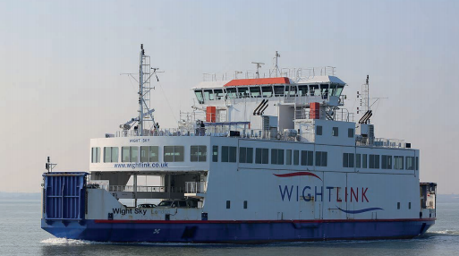
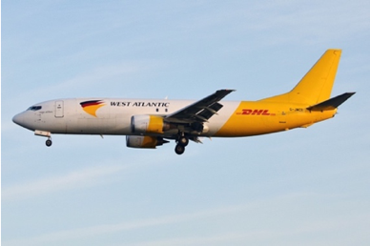
Accident Analysis
Marine
Aviation
Reproduced from MAIB Report 14/2018 © Crown Copyright 2018
Reproduced from flikr.com © Anna Zvereva, 2018
Catastrophic engine failure, resulting in a fire and serious injuries
Loss of power to co-pilots instruments/displays
On board Ferry Wight Sky, off Yarmouth
West Atlantic Boeing 737 on route to East Midlands Airport
21:33 on 12th September 2017
01:55 on 12th October 2018
Healthcare
Rail
Suicide whilst in transition from CAMHS to AMHS
Members of the public struck by 240v AC cable
18-year old Ben (not the person’s real name)
At Abergavenny (Y Fenni) station, Mid-Wales
18th October 2017
18:05 on 28th July 2017
Reproduced from RAIB Report 06/2018 © Crown Copyright 2018
Reproduced from www.childrensmentalhealthweek.org.uk

Slide 6
Marine

Slide 7



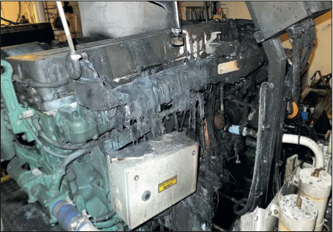
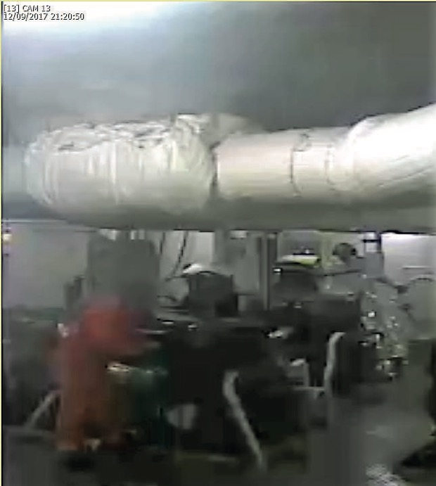
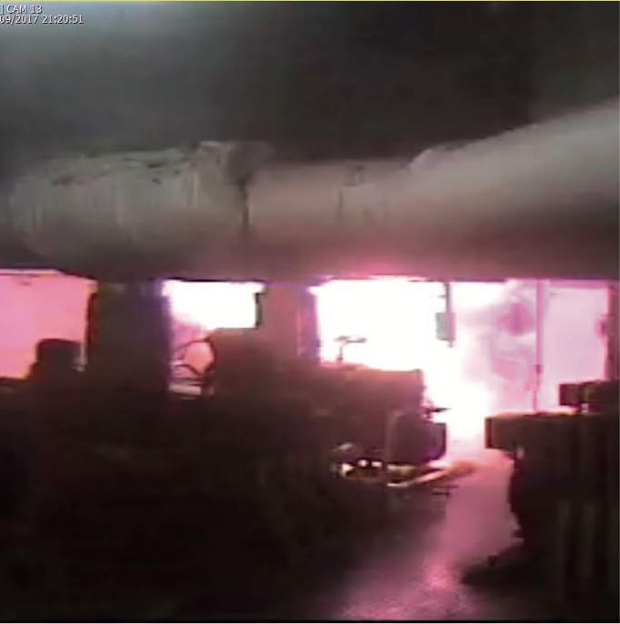
Engine failure on-board Ferry Wight Sky, 12 Sep 2017
7
All photos reproduced from MAIB Report 14/2018 © Crown Copyright 2018
Notes:
Accident
Approaching Yarmouth, Isle of Wight, Wight Sky suffered a major engine fire
Vessel’s engineer briefly engulfed in a ball of fire resulting in serious burns to his face and hands
Subsequently diagnosed with PTSD
Trigger
Engine OEM identified debris in the engine’s oil channel following a recent rebuild.
MAIB Analysis
Engine failed after only 5½ hours of operation;
Most of the visible damage was observed in and around cylinder unit 4 of ME2. The big end bearing was distorted radially (Figure 3a), white metal had melted onto the bearing pin on the crankshaft (Figure 3b) and two of the four big end bearing bolts had sheared at the joining face between the top and bottom halves of the bearing keep. The outboard side of the crankcase was punctured (Figure 3c), creating a large opening through which several components, including the gudgeon pin, connecting rod and fragments of the piston and cylinder liner had been ejected. There was fire damage on and around the engine (Figure 3d).
Soft patches had not been removed;
Debris likely entered the oil channels during period of partial assembly;
Analysis of oil samples indicated accelerated wear commenced before the failure;
Power to the fixed fire-extinguishing system was lost 27 minutes after the accident due to an earlier oversight in emergency system breaker management.
Analysis of Service Failures
“Maintenance” – Engine not re-assembled in a clean air environment, in accordance with OEM recommendations.
“Re-Installation” – Maintenance staff did not remove soft plates due to perceived disruption.
“Oil Monitoring” – Engine oil samples indicated accelerated wear but were not acted upon.

Slide 8
Service Assurance Principles - Wight Sky
1
REQUIREMENTS
Service Based Solution – “Engine Maintenance”
Requirements – OEM replacement/ installation instructions – clean environment
INTENT
Crew competence requirements met
Engine assembly and transit likely non-compliant with OEM requirements
2
3
SATISFIED
Engine Log Book unclear
No records correct process followed
4
UNINTENDED BEHAVIOURS
Credible Failure Scenarios not considered
5
CONFIDENCE
Some testing of the engine during day prior to incident
Tests were not sufficient to reveal the problem
6
MAINTAINED
Engine OEM – fresh guidance on good practice
effectively changing the specification of the maintenance service
Service Assurance Guidance document SCSC-156 (SAWG, 2020)
Notes:
REQUIREMENTS
Overall Service Based Solution = “Engine Maintenance”.
Likely to have been detailed engine manufacturer replacement/installation instructions applying to this service. These likely included mechanisms to ensure the engine was kept in a clean environment during maintenance, likely not followed.
Three earlier incidents involving the same engine type were identified in the report. It is not known if the crew of the WS were aware of these incidents.
INTENT
There were competence requirements on the vessel crew, and experience needs were met: “The master and engineer held STCW4 certificates of competency appropriate to their ranks. The master had 7 years’ experience and the engineer 26 years’ experience in their respective roles on board Wightlink ferries”
Leaving the engine partially assembled and would have left the possibility of ingress of foreign debris, hence the requirements flowed to each part of the maintenance process (involving method of reinstallation and cleanliness) were likely not complied with “However, ME2’s short block had been exposed to the elements for 3 days with only a loose plastic sheet for protection, and debris could have entered the oil channels during this time”
The way the maintained engine was lowered into position was likely against manufacturer recommendations “The soft patches were not used to move the engines in or out of the engine rooms due to the disruption their removal would cause. Therefore, RKM planned its work around the use of the emergency hatch. This required the engines to be partially disassembled and rebuilt in the engine room, transporting the majority of the components in the short block.
SATISFIED
There was a log book for the engine in use, but it is not mentioned how this was used except for “…the engineer went down to the forward engine room…to note the machinery running parameters for the logbook”.
There was no recorded evidence that the correct process for replacing the engine was followed, hence the service assurance requirements were not explicitly satisfied. It would be expected that there would be formal test records.
UNINTENDED BEHAVIOURS
The possibility of dirt or particle ingress into the engine should have been considered. This would have led to this issue being monitored as part of the continuing maintenance service. The report mentions that “As the engine was not fitted with a particle detector or other means of detecting rapidly progressing wear, there was no possibility of receiving an early warning before the engine failed”.
The possibility that the power supply to the essential services could be lost should have been considered as credible failure scenario “It shut down just after 2200 after the electrical power supply automatically switched over to the aft switchboard. As a result of an earlier oversight, the ES circuit breaker for the aft switchboard had been left in the manual mode, so the ES switchboard was left without power. This caused the loss of all essential services…”
CONFIDENCE
There was some testing of the engine: “The crew of the morning shift had tested … off load and had verified that all alarms and shutdowns were functioning correctly. During the afternoon shift, the vessel’s engineer tested the engine on load, and on departure from Lymington that evening all four main engines were sharing the sea load”, but clearly these tests were not sufficient to reveal the problem, i.e. they were not of the necessary duration type to reveal the contamination problem.
MAINTAINED
It is hoped that the ferry operator will follow the recommendations in the report, learn the lessons and improve the overall engine maintenance service accordingly. The engine manufacturer, Volvo Penta has written to all dealerships providing guidance on good practice (effectively changing the specification of the maintenance service):
“Where appropriate, soft patches are removed to allow removal and reinstallation of complete engines.
○ Engine assembly is completed in a clean environment to prevent debris being built into an engine.
○ Following rebuilds, engines are load-tested on a dynamometer and certificates issued confirming the required performance.
○ Records of component measurements are kept to confirm that they are within tolerance and fit for reuse”
There was an explicit recommendation on the engine manufacturer: “Consider offering wear particle detection technology for Volvo Penta marine engines that cannot be easily serviced on board”
DISCUSSION
This incident can be viewed as involving several services from different service providers:
The overall service is considered to be the “Engine Maintenance Service”, which can be considered to consume services from:
The engine maintenance operator (RKM), “Engine Rebuild and Reinstallation”,
The engine manufacturer (Volvo Penta), “Engine Maintenance Instructions and Guidance”, and
Those services provided by the vessel staff, including “Staffing”, “Engine Testing” and “Vessel Operation”.
It can be seen that all of the sub-services failed in some way, so contributing to the incident. The lack of explicit documentation makes it hard to establish what the individual service failures were but given the recommendations we can conclude that changes are required to all.
Note that the service assurance guidance goes on to suggest the use of service “wrappers” or assurance supplements; in this case the wrappers could include:
the additional “soak” testing of the engine;
better manufacturer guidance;
more rigorous oversight of the engine re-installation process and
the production of additional documentation to enable more detailed fault investigation.

Slide 9
Rail

Slide 10
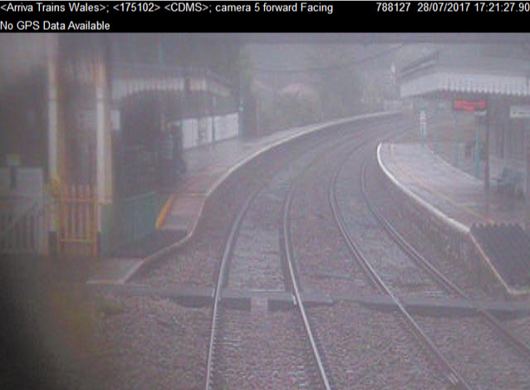
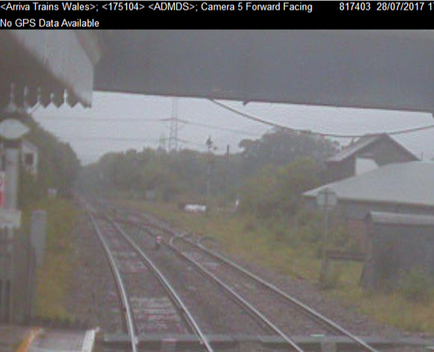
Public struck by 240v cable at Abergavenny (Y Fenni) station
10
All photos reproduced from RAIB Report 06/2018 © Crown Copyright 2018
Notes:
Accident
The roof of a northbound passenger train entering the station caught a 240v AC electrical cable hanging below the station’s footbridge.
Cable dragged and detached from fixings and distribution cabinet;
Free end struck 3 members of the public climbing stairs - minor injuries;
Collateral damage to other infrastructure.
Trigger
Wrong fixings used to hold cable against footbridge.
Accident likely at least 12 years after trigger was set.
RAIB Analysis
240v AC cable to Signal Box was hanging and caught an antenna on the train’s rear carriage;
Nylon cable ties used to hold the cable in place had failed;
Inspections of the cable and footbridge had not identified the cable was loose/hanging;
Lack of controls in Network Rail protocols for the management of low voltage supply cables, notably where they cross operational railway lines via overhead structures.
Analysis of Service Failures
“Installation” – black nylon cable ties unsuitable for exterior applications due to likely premature degradation – also cable ties weight bearing as cable tray hung vertically.
“Inspection” – BS 7671 wiring regulations requirement - split responsibility Network Rail / Arriva Trains Wales - each believed the other inspected the cable tray/fixings consequently they were inspected by neither.
Other “Inspection” failures - annual visual inspections were overlooked post 2016, despite the cable already noticeably sagging by that time.

Slide 11
Service Assurance Principles - Abergavenny
1
REQUIREMENTS
Safety = first priority in all service activities
Greater assurance focus across the network
Impact from degraded modes of service
INTENT
Service failings lack of ownership/accountability
Overarching SBS with clear agreements across service interfaces
2
3
SATISFIED
Identical services – different providers
Interwoven service/provider framework
Ambiguity over accountability for inspection
4
UNINTENDED BEHAVIOURS
Cable ‘installation’ using nylon cable ties.
Accountability for ‘installation’ service likely provider more diligent in choice of fixings
5
CONFIDENCE
service providers cognisant of safety risks
Level of risk understanding does not seem to exist around service assurance
6
MAINTAINED
‘inspection’ maintained commensurate with risk
Provider changes – level of diligence maintained
Overarching SBS provides enduring framework
Service Assurance Guidance document SCSC-156 (SAWG, 2020)
Notes:
REQUIREMENTS
It is well understood that rail networks are inherently high-risk environments, exemplified by Network Rail’s Safety Vision (Network Rail, 2019). It would seem reasonable therefore to expect safety to be the first priority in all service activities that take place across the network. Sadly, although stakeholder organisations would like to hope that is the case, accidents such as that at Abergavenny are still occurring. It would seem greater focus is required on the assurance of safety-related service activities across the rail network to determine the behaviours of those services and what unique mitigations need to be considered. This is where Principle 1 of the Service Assurance Guidance can help. Particularly of value from a services perspective would be consideration of the impact from degraded modes of service and prior service failings (such as a previous cable drooping incident from the same bridge in 2002) in defining a robust service architecture.
INTENT
The RAIB identified a number of service failings in this incident related to a lack of ownership or accountability. Network Rail own the rail infrastructure including the signal box but are not accountable for the station infrastructure, owned/managed by Aviva Trains Wales. Presumptions were made as to which organisation was accountable for the service of inspecting the cable tray affixed to the bridge in which the drooping cable was meant to be secured. In the end neither organisation inspected it. Had an overarching SBS been in place with clear agreements across service interfaces we would like to think inspections of the tray would have occurred because accountability for it would have been clearly defined/recorded.
SATISFIED
Services come in many guises; equally identical services can be delivered by different providers. The UK rail network is a classic example of this kind of interwoven service/provider framework. Although requirements for services exist, such as the monthly requirement for a station safety inspection, the ambiguity over accountability for inspection of the cable tray led to that service not being wholly enacted. Had the requirements been more explicit from a service provision/accountability perspective in line with Principles 1 and 2 then satisfactory compliance with the service requirements would hopefully have mitigated the drooping cable.
UNINTENDED BEHAVIOURS
Failings in the ‘inspection’ service can be seen as consequential mitigation failures. The main service failure in this incident was that of ‘installation’ of the cable using inappropriate nylon cable ties. The RAIB cannot be certain of an exact date but the ‘installation’ error certainly happened at least 4 years before the incident and potentially as far back as the early 1990s. Clearer understanding of their accountability for the ‘installation’ service would likely have made the engineer involved and their parent company more diligent in ensuring more appropriate fixings were used.
CONFIDENCE
In such a high-risk industry one would like to think the service providers are fully cognisant of the safety risks they face and have confidence in their approaches to manage them. The reason a lot of rail accidents occur is that an equivalent level of risk understanding does not seem to exist around their service provision.
MAINTAINED
As a service, ‘inspection’ needs to be maintained at a level commensurate with the risk/impact of a failure of the item(s) being scrutinised. Periodic inspections, such as those mandated by BS7671, as detailed in the RAIB report (RAIB, 2018), need to be held. Although Arriva Trains Wales maintained the services they were accountable for, there is no certainty that a future franchise operator would adopt the same level of diligence. An overarching SBS considering the Service Assurance Principles would provide an enduring framework to support the assurance of extended services like ‘inspection’.
DISCUSSION
It is important to recognise the complete suite of services that make up an SBS not only those that are currently being enacted but also those provisioned earlier in the lifecycle of the affected safety-critical system, in this case a section of the UK rail network. Services can fail sometime after they were first delivered, as in the ‘installation’ service at Abergavenny. Well-thought-out analysis of service provision, both spatially and temporally can be reinforced by use of the Service Assurance Guidance, which provides a framework to link the assurance of services across an industry sector identifying where weaknesses exist in the service assurance map, critical in industries where safety-related services predominate.

Slide 12
Conclusion
“Safety II” view
Reflection
Consideration through “service lens”
Varied ways safety-related services can fail
Aspects failures mitigated by Service Assurance Guidance
Future Work
Establish service analysis in accident investigation
Service Analysis Techniques e.g. Bow Ties
Apply Objectives of Principles to more examples
Guidance v2.0 by SSS’21
Notes:
Reflection on our analysis
Consideration through “service eyes” can be useful, helping to analyse the accident if the implicit and explicit services are identified together with the failures of those services;
There are varied ways in which safety-related services can fail leading to an accident;
Some aspects of the failures could be mitigated by application of the Service Assurance Guidance.
Establishing whether the objectives were met in the particular accident scenarios – We feel an update to accident investigation methods is required.
Fuller list of analysed accidents in our guidance document
Service Analysis Techniques – Service Bow Ties, Service FFA etc – see guidance
Accident Reports:
Often list causes or contributory factors related to the way services are constructed.
Do not currently consider service failings, we believe they should.
As per “Safety II” many service failures never result in accidents because components of the service (often the staff) are resilient and prevent the chain of events from a specific failure turning into an accident.

Slide 13
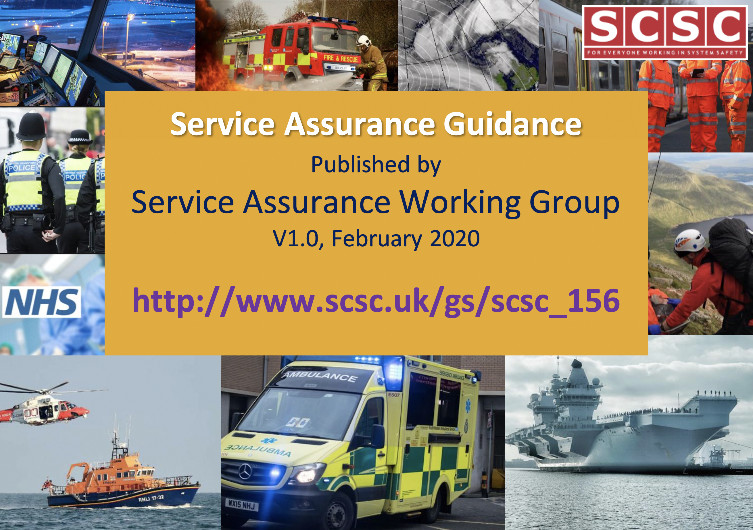
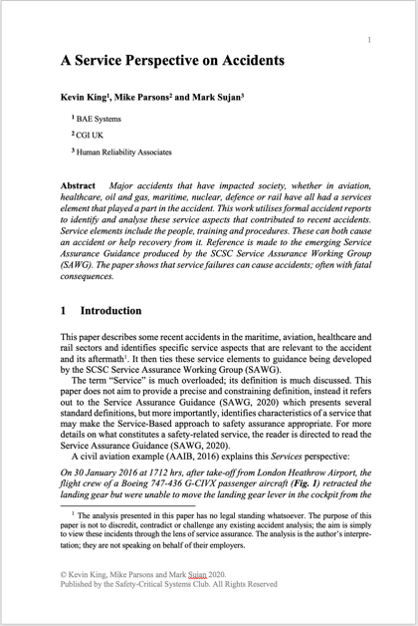
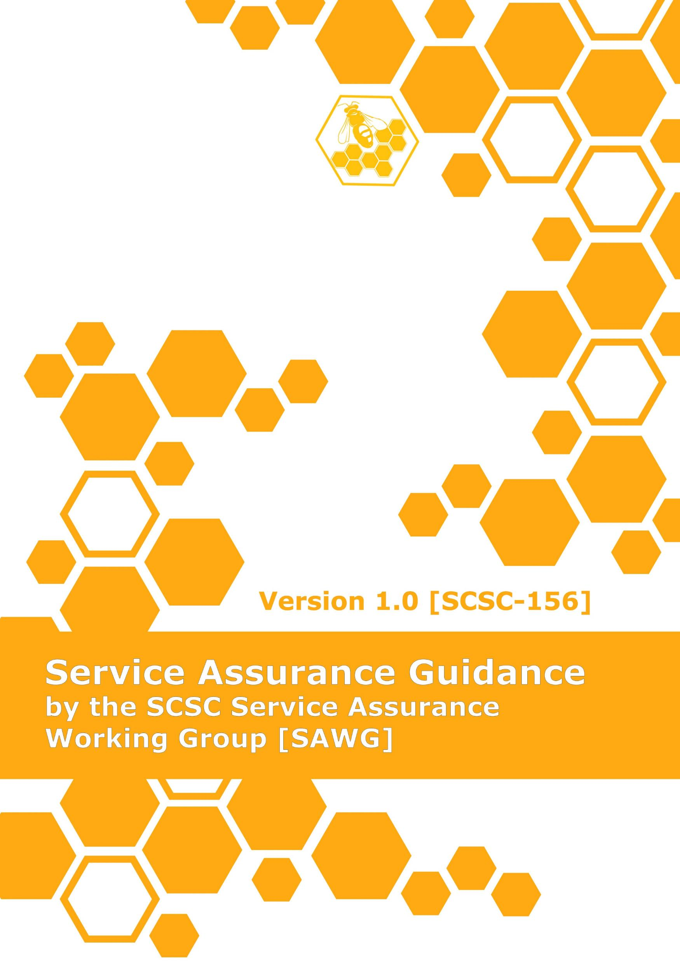
Further Information
SSS’20 Proceedings Paper
Service Assurance Guidance:
http://www.scsc.uk/gs/scsc-156
  Flyer in Delegate Pack
  If you have an interest in Service Assurance, why not join the working group. More details at:
  https://scsc.uk/gs

Slide 14

Takeaway
Service Assurance is not easy, but it is essential!
Services underpin every safe product delivered
Understanding the full scope of services and their assurance is paramount

Slide 15
Thank You

Slide 16
Credits
This is where you give credit to the ones who are part of this project.
Did you like the resources on this template? Get them for free at our other websites.
Presentation template by Slidesgo
Icons by Flaticon
Images & infographics by Freepik
Infographics by new7ducks - Freepik.com
Photos created by pressfoto - Freepik.com
Content slide photo created by chokniti - Freepik.com
Team slide photos created by benzoix and nensuria - Freepik.com
Author introduction slide photo created by katemangostar - Freepik.com
Image slide photo created by evening-tao - Freepik.com

Slide 17
Instructions for use
In order to use this template, you must credit Slidesgo by keeping the Credits slide.
You are allowed to:
- Modify this template.
- Use it for both personal and commercial projects.
You are not allowed to:
- Sublicense, sell or rent any of Slidesgo Content (or a modified version of Slidesgo Content).
- Distribute Slidesgo Content unless it has been expressly authorized by Slidesgo.
- Include Slidesgo Content in an online or offline database or file.
- Offer Slidesgo templates (or modified versions of Slidesgo templates) for download.
- Acquire the copyright of Slidesgo Content.
For more information about editing slides, please read our FAQs:
https://slidesgo.com/faqs

