Slide 1
Principles of Service Assurance
A position paper by
Nick Durston, Andy Scott, Mike Parsons and Alan Simpson
Drawing on the work of the SCSC Service Assurance Working Group (SAWG)

Slide 2

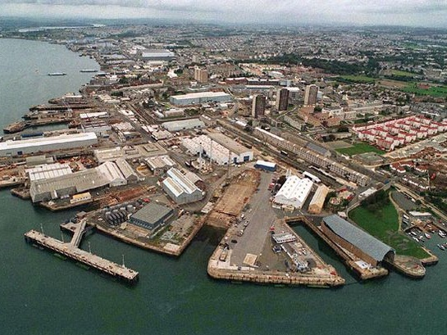


Background
Many safety-related systems are delivered in a service context
Collaborative working of systems, organisations, people & processes contributes to the safety of the service
A service based approach to assuring safety may provide a unique, useful and possibly essential perspective
The SCSC Working Group is exploring the issues with a view to producing guidance
  WORK IN PROGRESS – no solid conclusions as yet
  Broad spectrum of industries / interests represented
  Looking for more input – crossover and collaboration
Our paper draws on work of the SCSC SAWG
Notes:
1.3.4 The SCSC Service Assurance Working Group
The Service Assurance Working Group (SAWG) has been set up by the Safety-Critical Systems Club comprising members from UK industry and academia (SAWG, 2017). It is focused on providing guidance for the safety assurance of Service-Based Solutions. Much of the material presented in the paper is a result of contribution to and discussion in the Working Group during 2017. The work of the Group is on-going; this presentation summarises the conclusions to date and issues requiring further effort.

Slide 3


Context and Motivation
Three key questions keep us awake
  What are the characteristics of services that distinguish Service Assurance from System /Product Assurance?
  What are the key principles that must be addressed in Service Assurance?
  What objectives do we need to demonstrate?
We believe addressing these will help provide the basis for guidance material

Slide 4

Where did we get to?
We re-wrote our thinking on service characteristics
1
Proposed a set of principles for assuring services*
2
Examined the principles against the characteristics
3
Looked at how principles applied in a service scenario
4
Brainstormed the key Objectives against each principle
5
Since completing the paper the principles continue to be challenged and refined
We anticipate the application of the principles will form the basis of future guidance material
Based on established Software Assurance Principles
Notes:
Organisations are increasingly using the paradigms of Services and Service Oriented Architectures (SOA) to deliver their aims. SOAs provide the capability to integrate third-party Commercial Off-The-Shelf (COTS) services with services developed in-house to provide value-generating services to customers. An organisation can use this to their advantage by focusing on the provision of in-house and customer-facing services. They buy-in generic, “commodity”1 services and so off-load the complexity, expertise and non-safety risk associated with providing those services to their suppliers via commercial relationships. This use of services can work in many different sectors, e.g. from hospital cleaning to train fleet maintenance.
The SOA approach can be applied to many of the services that support an enterprise such as Facilities Management and Physical Security as well as In-formation Technology (IT) services such as Web Services, Cloud Computing, Cyber-Security and Network Services.
Cloud Computing capabilities provided by Amazon Web Services, Microsoft’s Azure and others are beyond what even a large enterprise can provide from an in-house platform
Robust Cyber-Security requires a very high level of sophistication and knowledge, individual enterprises are increasingly unable to maintain the level of expertise in-house needed for effective protection, and so buy-in Cyber-Security service from expert providers

Slide 5
What do we mean by Service?
Both Service and System are defined in many different ways and used interchangeably
If we define System as something like
  A set of components interconnected for a purpose
Then a Service is realised by a System
So when does a System become a Service?
  When one organisation contracts another organisation to provide a System in a given context
The purpose of this Service might be
  Design and production of a product
  Maintenance or Operation of another System
  Functionality/Data to support another System
  Change, refurbishment or disposal of another System
  Cleaning, pizza delivery, taxi, etc.

Slide 6
What is a Service Based Solution?
Systems, organisations, processes and resources to deliver and manage services through life
An SBS delivers capabilities to its customers via a set of collaborating services
A well-formed SBS has a hierarchy of services with
  specialised, domain-specific Customer Facing Services
  constructed from generic, re-usable Internal (or Resource Facing) Services
Notes:
2.1 How a Service is described
The way that a Service is normally described is different to the system specifications and descriptions more commonly used in the safety-related context. A Ser-vice is typically described by the Service Provider via an entry in a Service Catalogue. The Service Catalogue typically describes the capabilities/functionality offered to a Consumer without providing implementation detail. It is unusual for the design and implementation of the Service to be visible to the Consumer.
Service Level Agreements are used to define the level of service being offered, this may include non-functional properties such as: capacity, performance or availability. SLAs may describe any penalties on the Service Provider for not meeting the agreements. A similar model and approach can be used for non-IT services.
Service Contracts between the Provider and Consumer provide the legal and commercial agreements and typically refer to Service Catalogues, Statements of Work (SoW) and SLAs.
The boundary between a Service Consumer and a Provider is typically an organisational and commercial boundary as well as a technical one.
A Consumer may not be involved in the specification and development of a Service and instead may select a standardised Service. Alternatively, they may be involved in the creation of new or tailored services.

Slide 7
Characteristics of a Service
Provided for the duration of the service contract
Often designed to meet the needs of a broad range of consumer needs
Likely to be used by more than one consumer at the same time
Implemented through people, organisations, products and other services
May be designed without recognition of the full context of use
Implementation details may not be visible to the end user
Implementation may change frequently and significantly
May include exclusive features for the maintenance or monitoring of other services
Often multi-layered – layers may be invisible to the Consumer
Notes:
Service
Characteristic
Context
Services are provided for the duration of the service contract
By definition services provide features with a given performance for the duration of the contract between provider and consumer. So e.g. the consumer does not have to be concerned with the design, maintenance or disposal of the service components.
Services often designed to meet the needs of a broad range of consumer needs
Providers want to attract a broad range of customers, and may wish to avoid too many bespoke solutions
Services likely to be used by more than one consumer
Providers usually desire to sell similar service offerings (catalogs) to a wide range of customers, so multiple consumers can be using the same service offering at the same time (or sharing resources of other services)
Services are implemented through a combination of people, organisations, products and other services
Service implementation requires the collaborative working of people, processes, products and other services to deliver a set of features with the desired performance
Services may be designed without recognition of the full context of use
Providers may desire a quick route to market, so may be released before the full context is understood . The service may be designed to adapt to context of use or may evolve overtime to meet the emerging context of use. Services may be developed for specific purposes that other users decide to exploit (unexpected use)
Service implementation details may not be visible to the consumer
Whilst the performance and features of a service should be clear to the consumer, the details of how the service are delivered may be kept confidential or be hidden within other lower tier services
Service implementation may change frequently and significantly
Providers may be looking to maintain and obtain commercial advantage, to streamline service provision, reacting to other consumer requirements, external issues (e.g. new security threats), etc.
Services may include or provide exclusive features for the maintenance or monitoring of the service or other services
Service covers a broad range of scenarios e.g. from the service to provide a product through to a service to inspect an installation, audit another provider, dispose of a product, etc.
Services are often multi-layered
Consumers may not be aware of all the services used by the service provider. Sub-layers of providers often become more generic and commoditised, and can use common service suppliers, some requirements (e.g. for location and diversity) are often inadvertently and silently not met.

Slide 8
Service Assurance Principle
1
Service assurance requirements shall be defined for the particular service instance and expected usage, to address the SBS’s contribution to the undesired behaviours of the overall system
Example Objectives
Context and intended use of the SBS SHALL be established
Historical accidents and incidents related to the service offering SHALL be identified, reviewed and lessons learnt
Key stakeholders SHALL be identified
Service assurance requirements for the SBS SHALL be established
A service assurance assessment SHALL be planned
Service analyses SHALL be planned
Need to assure transition from old service to new service
Services may not meet all requirements and may exhibit undesired behaviours
Service providers may be responsible for assuring the service assurance requirements
Example Issues
Notes:
Assurance Principles are not specific to Provider or Consumer

Slide 9
Service Assurance Principle
2
The intent of the service assurance requirements shall be maintained through the service definitions, service levels, the service architecture and the agreements made at service interfaces
Example Objectives
Service assurance requirements SHALL be allocated to service elements within the service architecture of the SBS
Service assurance requirements tracing through the service architecture SHALL be established
Methods used to provide service assurance within each level of the service architecture SHALL be defined and implemented
Assurance wrappers SHALL be identified and defined for service components to make good any assurance shortfall
Service provider and service consumer must agree the interface between them
Assuring performance requirements are met involves static and dynamic evidence
Service level agreements may need more complex change management procedures that allow for varying degrees of autonomy
Neither service provider nor service consumer may be able to establish the full service hierarchy
Example Issues
Notes:
Assuring that performance requirements are met will involve both static and dynamic evidence. Static evidence relates to properties that can be proved once such as at certification. Dynamic evidence relates to man-agement of real time behaviour to prove there is an effective process for ongoing assurance.

Slide 10
Service Assurance Principle
3
Service assurance requirements shall be satisfied
Example Objectives
Service assurance requirements SHALL be verified at an appropriate level within the service architecture of the SBS
Service assurance artefacts SHALL be identified
Evidence SHALL include proven in use and service history evidence
Assurance wrappers SHALL be established and fulfilled
Service assurance requirements need only be satisfied for the duration of the service contract
Services may have more features than required
Potential for service interference or disruption must be analysed
Service may not be compatible for specific context of use or may change over time
May not be possible to assess evidence of implementation robustness
Example Issues

Slide 11
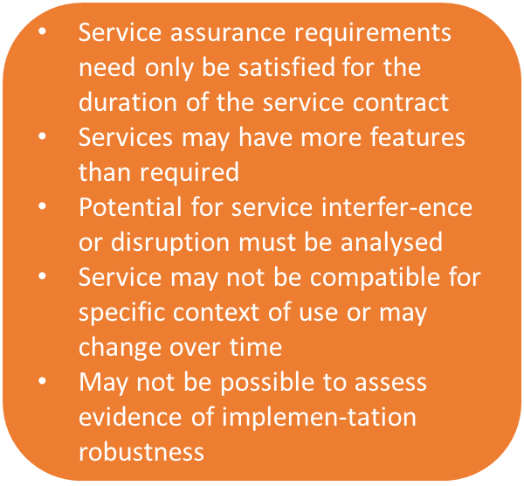
Service Assurance Principle
4
Undesirable behaviours of the SBS shall be identified, assessed and managed
Example Objectives
Undesirable behaviours resulting from the service architecture and service elements SHALL be identified, analysed and managed
Service assurance artefacts SHALL be identified and produced according to the SAL (see 5 below)
Residual risks SHALL be identified and linked to service artefacts and service properties
Example Issues

Slide 12
Service Assurance Principle
5
The confidence established in addressing these principles shall be commensurate with the level of risk posed by the SBS
Example Objectives
Service Assurance Levels (SALs) SHALL be established based on the level of risk that the service poses
SALs SHALL support system assurance activities
Methods, analyses and tools used to provide service assurance SHALL be defined and implemented according to the SAL
Service assurance artefacts SHALL be produced according to the SAL
Frequent changes may degrade or undermine confidence over time
May not be possible to assess evidence of implementation robustness
Confidence levels for most consumers may not be sufficient for safety related SBS
Confidence must be continuously assured through the contract period
Example Issues

Slide 13
Service Assurance Principle
6
These principles shall be established and maintained throughout the lifetime of the SBS through all changes, e.g. commissioning, operations, change of provider, re-purposing and end-of-life
Example Objectives
All changes to the SBS SHALL be assessed for impacts, including impacts on meeting these objectives
Service assurance artefacts SHALL be maintained
All uses of the SBS must be monitored; if it is used for a new purpose, or the scope changes then this SHALL cause a re-evaluation of the compliance with the objectives
Service contracts must include per-formance management to ensure key performance is monitored and issues rectified or services terminated
SLA changes must be agreed by both parties
Dynamic evidence to be continuously or routinely monitored to ensure the service is effective
Example Issues

Slide 14

Satisfaction of Objectives?
The principles relate to the SBS and its constituents
Objectives may be satisfied by either the Consumer or the Provider
  Or be shared
Providers may not be willing or able to contribute to or justify satisfaction
Evidence of satisfaction may be difficult or impossible to obtain
Assurance of competency for critical roles
BUT claims, evidence and arguments needed to show satisfaction of the Service Assurance Principles

Slide 15
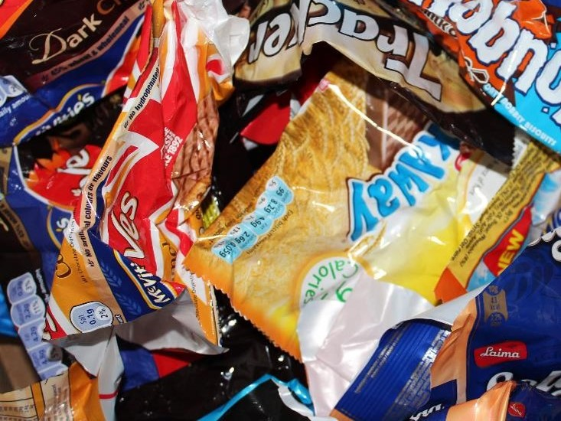
Service Assurance Wrappers
Assurance is needed at the point of the service’s integration into the overall architecture
The Service Assurance Wrapper is the specific assurance that enables the service to be safely used by the consuming service
The scope and complexity of the wrapper depends on e.g.
  Criticality of the service
  Service providers’ willingness to provide any or all of the required assurance evidence
  Change to the service implementation over its lifetime
Notes:
The assurance is used at the point of the component’s integration into the overall architecture, reconciling what the component offers (both functionally, as well as in terms of any assurance evidence that may be presented for the component’s behaviour) with the specific ‘needs’ of the wider system. When presented for one or more services to be consumed by the parent system, this assurance is referred to as a ‘service assurance wrapper’. Hence in a typical service hierarchy, the assurance wrapper is the specific assurance that enables the lower-level service
The Principles of Service Assurance 75
to be safely used by the consuming service. The scope and complexity of a ser-vice assurance wrapper will vary to accommodate service characteristics includ-ing:
• Criticality of the service (i.e. related to the consequences of the service fail-ing to behave as specified.)
• Service providers being unable or unwilling to provide any or all of the re-quired assurance evidence.
• Change to the service implementation over its lifetime (e.g. due to the service provider’s organisation or technology, or due to the replacement of one ser-vice provider with another).

Slide 16
Assurance Wrappers in Context
Notes:
Figure uses different circle line weights to illustrate how some wrappers may be ‘thicker’ (more complex, more in-depth) than others. This illustration serves to reflect that wrapper complexity is not a simple function of the class of wrapper (see Wrapper Classes , as it will also be influenced by the degree of dependence on the consumed service and the nature of its integration into the overall architecture.
It should be noted that an organisation that develops an assurance wrapper may be the service consumer itself, the service provider, or a third party. How-ever, the consumer of a service remains accountable for the claims made in the associated assurance wrapper. At the highest level of the architecture, where safety risk can be understood, this will be the ‘Duty Holder’ for the overall sys-tem. Finally, note further that different services from the same provider may well require wrappers of different classes.

Slide 17
Wrapper Classes
Class | Case | Consumer Perspective | Example Key Aspects for Wrapper to Demonstrate
Transparent | 1a | Can flow down assurance requirements to a capable, domain & safety-aware supplier | Safe integration of the service into the SBS Adequate review of assurance deliverables Service provider compliance with consumer safety requirements, standards and legislation Mechanisms to alert the consumer to service changes
 | 1b | Can flow down assurance requirements to a safety-aware service provider, albeit may not be fully domain aware | As above But with more robust arguments regarding clarity of requirements & management of assumptions
Translation | 2 | Can flow down assurance requirements to the service provider, albeit the provider is not safety-aware | As above Evidence provided for the service behaving as specified is sufficient in context and dependencies on it More robust reporting / control mechanisms for changes to service provision
Total | 3 | Requirements are not flowed down to the provider | Assurance Case for both the service and its use Evidence of service performance from extant use Robust arguments on how the consumer controls impact from changes to the service provision

Slide 18
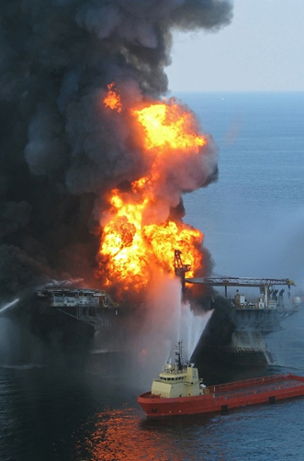
Case Study – Deepwater Horizon
On the evening of 20th April 2010 a well control event allowed hydrocarbons to escape from the Macondo Well onto Transocean’s Deepwater Horizon
This resulted in explosions and fire on the rig
Eleven people lost their lives and seventeen others were significantly injured
The SAWG examined the accident report in light of the Services Assurance Principles

Slide 19
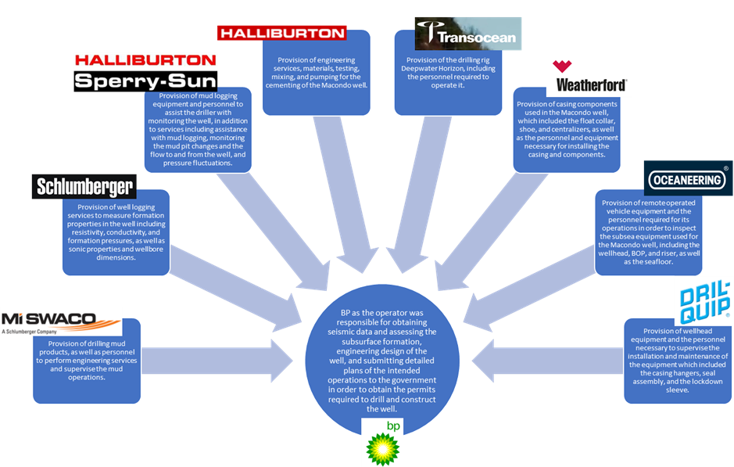
8 different Service Providers
Evidence from the accident report implies
  Objectives in relation to SAP1 met
  Insufficient evidence that assurance activities were planned or evidence gathered in relation to SAP2 and 3

Slide 20

Where Next?
Meeting the principles in practice
  Inter-service interference
  Unintentional or undesired service provision
  Repurposing in a safety context
  Managing and transferring risk between Service Layers
  Management of undesired Emergent Properties
  Meeting the ALARP principle
Assuring confidence in the evidence
  Analysis of Contractual Documents
  Assuring completeness of safety analyses and evidence
  SLA Confidence
  Who assures?
  Building coherent and acceptable wrappers, esp. Translation and Total classes
Other issues to consider?
  Managing Safety and Security Assurance
Notes:
• Inter-service interference (e.g. where consumption of two or more apparently independent services causes degradation as they make use of the same un-derlying resources: people, equipment, cables, etc.)
• Unintentional or undesired service provision (e.g. where a service becomes consumed because it is readily available, but the service provider has no knowledge or intention for the service to be consumed this way. An example might be harvesting of radio waves to power Internet of Things devices.)
• Repurposing in a safety context (this is where a service is provided for a particular use, but an additional safety-related usage of the service was never intended by the service provider.)
• Assuring completeness of safety analyses and evidence (it can be difficult in a complex service hierarchy to see how the risks are completely addressed, as risks may be managed at different service layers.)
• Managing and transferring risk between Service Layers (this is related to the bullet above – risks not properly managed at one level may need to be ad-dressed at higher levels. A mechanism for formally transferring risks is needed.)
• Management of undesired Emergent Properties (the way a service is con-structed may lead to undesired or detrimental properties emerging through the interaction of services in the hierarchy. New analysis methods will likely be needed to identify these.)
• Analysis of Contractual Documents (Technical / legal analysis of SLAs and Statement of Work (SoW) may be required, and conclusions for the assur-ance case produced. This may require specialist legal or commercial skills.
• SLA Confidence (there needs to be a way of establishing the level of confi-dence that a specific SLA will be met. It may be possible to do a “assurance analysis” of the SLA itself, to establish a confidence level.)
• Meeting ALARP (the As Low As Reasonably Practicable (ALARP) princi-ple may need to be considered for services. This is especially true when a service provider potentially doesn’t know which of their services (or specific characteristics of specific services) will subsequently be relied on to satisfy some higher-level safety claim.)
• Who Assures? (it will be necessary to establish who is doing the assurance in a service stack as the picture could be complex – does each service pro-vider or supplier just assure their “level” in the stack? Who has the overall picture? Note that failures may propagate across service layers. This may result in functional requirements for notification, including auditing, correc-tive actions, etc. This would need to be reflected in contractual arrange-ments.)
• Security (there is a need to feed in outputs of security analyses into the ser-vice assurance picture to give “security informed safety services”.)
• Argument Patterns (limited number of common patterns for Service Assur-ance arguments need to be established.)
• Modular Assurance (there is a natural mapping from service decomposition to modules within a modular assurance argument. The service definitions and SLAs may also map to interfaces between modules. This requires further investigation.)
• Changes to COTS (COTS items may be acquired to deliver services, but they are often modified or configured through their deployment, and this may be different from a reference architecture. Understanding how any design deltas can influence service behaviours is essential to constructing the assurance picture.)

Slide 21

Concluding thoughts …
We have established
  There are unique characteristics of a service that need special assurance consideration
  Six principles for service assurance and links to lower-level objectives
Further work to establish guidance on the application of the principles and objectives
  Dealing with the unique characteristics of services
Service assurance wrappers can be used to create and maintain the service assurance position
Together this will form a coherent and useful framework to assure services

